Slide 1
Java Programming: From the Ground Up
Lecture 19
Chapter 19 – Part 1
Event-Driven Programming

Slide 2
Objectives
Understand events and event handling
Understand event-driven programming
Understand event delegation model
Understand various events: button, radio button, mouse, mouse motion, menu, checkbox, text, text area, label, dialog, etc.
Understand listener interfaces
Understand listener methods
Be able to develop listeners

Slide 3
Events
An event is
an occurrence, an episode, a happening, an incident, an occasion.
Pressing a button or selecting a checkbox is an event.
Choosing an item from a menu is also an event.
Simply moving the mouse is an event.
Events happen.

Slide 4

Events
Clicking the X button that you see in the upper right hand corner of a window “generates” or “fires” an event.
Clicking the printer button fires an event.

Slide 5
Events
The system “responds” to this event by closing the window.
The response sends a document to the printer.
An application can ignore an event or respond to an event.
Programs that respond to events are called event-driven programs

Slide 6
The Delegation Event Model
The delegation event model is Java’s mechanism for handling events.
The delegation event model specifies that when an event is generated by some source such as a button or the mouse, the response is delegated or handed over to some other object.
When a user presses an Exit button (the event source), the button object does not close the application; another object carries out or handles the response.

Slide 7
The Delegation Event Model
Whenever an event is generated, such as clicking a button, checking a checkbox, or pressing a key, an event object belonging to the EventObject class is automatically instantiated.
This event object encapsulates information about the event including the source of the event -- a button, the mouse, a checkbox, a menu item -- along with other pertinent information such as the number of mouse clicks, the current screen position of the mouse, or whether or not a checkbox is checked.

Slide 8
The Delegation Event Model
The event object generated by the source object is passed to one or more listeners.
A listener is an object with methods that process or handle the event.
The listeners do the work.
When you click the printer button, that event is sent to a listener object, which then sends a message to the printer. It’s not the button that notifies the printer; a listener does that.
A listener object waits until an event is passed to it. When the listener receives an event, the listener responds to the event.

Slide 9
The Source Object
The source object is the component which generates an event.
The event source may be a button, a textbox, a list, a mouse, a checkbox, a radio button, a key, a scroll bar, a menu item, or some other component

Slide 10
The Event Object
Event objects are generated automatically; they encapsulate information about the event, and the programmer chooses whether to handle or ignore the event.
When a button is clicked or a menu item selected, an ActionEvent object is created.
When a checkbox is checked or unchecked, an ItemEvent is instantiated.
When a key is pressed, a KeyEvent is generated.

Slide 11
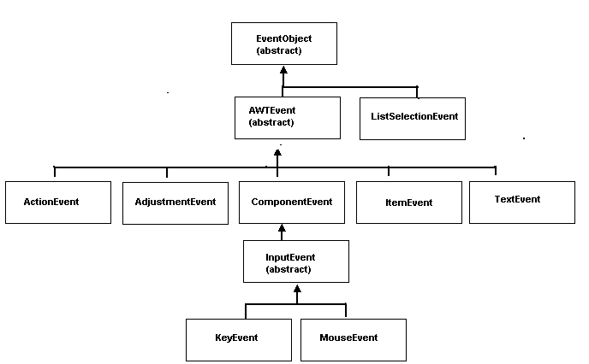
A partial view of the EventObject hierarchy

Slide 12
The Event Object
EventObject, which belongs to the java.util package defines two important methods:
Object getSource() returns the source of the event such as a reference to a particular button or checkbox, and
String toString() returns a string equivalent of the event.

Slide 13
The Listener
A listener waits or “listens” for an event to occur. A listener is automatically notified when certain events occur.
When a button is pressed, a listener associated with the button is notified and responds.
When the mouse is clicked a “mouse listener” is sent a message and responds.
Every listener must implement one or more listener interfaces.

Slide 14
The Listener
The listener responsible for the button event must implement the ActionListener interface in the java.awt.event package:
public interface ActionListener
{
public void actionPerformed(ActionEvent e);
}

Slide 15
The Listener
To receive events from a source, a connection must be established between the source and a listener.
If no connection is established, the listener listens forever while the source generates unprocessed events.
It is the source’s job to register the listener by invoking a “registration method.”

Slide 16
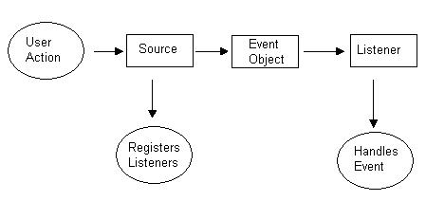
The event delegation model

Slide 17
The event delegation model
Event handling is a two step process:
Create a class that implements the appropriate listener interface(s).
Register the listener objects with the event source by using the “add___Listener” methods (e.g., addActionListener(…), addItemListener(…), addMouseListener(…), addKeyListener(…), etc). This registration makes the connection between the listener and the source.

Slide 18
Problem Statement:
Design a GUI application consisting of a single frame with three buttons labeled Hello, Goodbye, and Exit.
Pressing the Hello button displays the String “Hello” in the frame,
pressing the Goodbye button displays “Goodbye”, and
pressing the Exit button closes the frame and terminates the application.
When the program begins, the frame is empty.

Slide 19
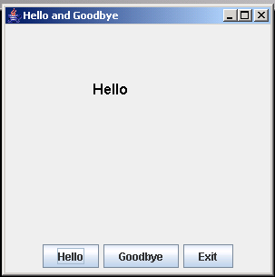
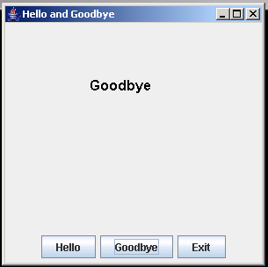
A frame with three buttons
Set up the GUI. Extend JFrame
Instantiate three buttons.
Place the three buttons on a panel.
Place the panel in the SOUTH area of the frame.
Override paint(Graphics g) so that the method paints a string (“Hello” or “Goodbye”) in the frame.

Slide 20
Source Code
import java.awt.*;
import javax.swing.*;
public class HelloAndGoodbye extends JFrame
{
private JButton helloButton;
private JButton goodbyeButton;
private JButton exitButton ;
private String message;
public HelloAndGoodbye() // constructor
{
helloButton = new JButton("Hello");
goodbyeButton = new JButton("Goodbye");
exitButton = new JButton("Exit");
message = "";
// initializes message to the empty string, if no // button is pressed, nothing appears setTitle("Hello and Goodbye");
setBounds(0,0,300,300);
JPanel buttonPanel = new JPanel();
buttonPanel.add(helloButton); // add buttons to panel

Slide 21
Buttons Application
buttonPanel.add(goodbyeButton);
buttonPanel.add(exitButton);
add(buttonPanel,BorderLayout.SOUTH); // add panel to the frame
setVisible(true);
}
public void paint (Graphics g) // override paint()
{
super.paint (g);
Font f = new Font("Arial", Font.BOLD,16);
g.setFont(f);
g.drawString(message,100,100);
}
public static void main(String[] args)
{
HelloAndGoodbye frame = new HelloAndGoodbye();
frame.setDefaultCloseOperation(JFrame.EXIT_ON_CLOSE);
}
}

Slide 22
Listener – Event handling
// as before
}
}
Design a listener class that implements the appropriate listener interface(s).
Clicking a button always generates an ActionEvent object.
The appropriate listener interface is ActionListener.
To handle an ActionEvent:
Declare a listener class that implements the ActionListener interface.
Implement the single method of ActionListener, actionPerformed(ActionEvent e)

Slide 23
ButtonListener class
// the ButtonListener class, an inner class that handles button events.
private class ButtonListener implements ActionListener // the listener
{
public void actionPerformed(ActionEvent e)
{
if (e.getSource()== helloButton) // event source is helloButton
{
message = "Hello"; // change the message String
repaint(); // repaint the frame
}
else if (e.getSource() == goodbyeButton) //source is goodbyeButton
{
message = "Goodbye"; // change the message string
repaint(); // repaint the frame
}
else // the source is exitButton
System.exit(0);
}
}
}

Slide 24
Register the listener
Register the listener to make a connection between the button and the listener.
helloButton.addActionListener(new ButtonListener());
goodbyeButton.addActionListener(new ButtonListener());
exitButton.addActionListener(new ButtonListener());

Slide 25
The complete application
import java.awt.*;
import javax.swing.*;
import java.awt.event.*;
public class HelloAndGoodbye extends JFrame
{
private JButton helloButton;
private JButton goodbyeButton;
private JButton exitButton ;
private String message;
public HelloAndGoodbye()
{
helloButton = new JButton("Hello");
goodbyeButton = new JButton("Goodbye");
exitButton = new JButton("Exit");
message = "";
setTitle("Hello and Goodbye");
setBounds(0,0,300,300);
JPanel buttonPanel = new JPanel();
buttonPanel.add(helloButton);// add buttons to panel
buttonPanel.add(goodbyeButton);
buttonPanel.add(exitButton);
add(buttonPanel,BorderLayout.SOUTH);
// register the listener with each button
helloButton.addActionListener(new ButtonListener());
goodbyeButton.addActionListener(new ButtonListener());
exitButton.addActionListener(new ButtonListener());
setVisible(true);
}

Slide 26
The Listener
public void paint(Graphics g)
{
super.paint(g);
Font f = new Font("Arial", Font.BOLD,16);
g.setFont(f);
g.drawString(message,100,100);
}
private class ButtonListener implements ActionListener
{
public void actionPerformed(ActionEvent e)
{
if (e.getSource()== helloButton)
{
message = "Hello"; // change the message
repaint(); // repaint the frame
}
else if (e.getSource() == goodbyeButton)
{
message = "Goodbye"; // change the message
repaint(); // repaint the frame
}
else // the source is exit Button
System.exit(0);
}
}

Slide 27
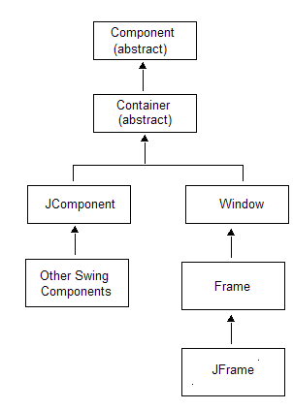
Component and JComponent
Most Swing components inherit from Component and JComponent.
JFrame extends Component and Container, but not JComponent.

Slide 28
Component
As a subclass of Component, each Swing component inherits methods defined in Component, including:
void setSize(int width, int height)
void setLocation(int x, int y)
void setBounds(int x, int y, int width, int height)
void setEnabled(boolean b)
void setVisible(boolean b)
void setName(String s)
void setFont(Font f)
void setBackground(Color c)
void setForeground(Color c)
void resize(int width, int height)
void repaint()
int getHeight()
int getWidth()

Slide 29
Component
int getx()
int gety()
int getName()
Color getBackground()
Color getForeground()
boolean isEnabled()
boolean isVisible()
All components also inherit
Component add(Component c), and
void setlayout(LayoutManager layoutManager)
from Container.

Slide 30
Buttons
Class: JButton
Generates: ActionEvent
Listener: Must implement ActionListener
Listener method to implement: void actionPerformed( ActionEvent e)
Register a listener: void addActionListener(ActionListener a)

Slide 31
JButton Constructors
JButton() instantiates a JButton object that displays neither text nor image.
JButton(String text) instantiates a JButton object that displays text.
JButton(Icon icon) instantiates a JButton object that displays an image; can be invoked as JButton button( new ImageIcon(String filename)), where filename is the name of a graphic file such as zap.gif.
JButton(String text, Icon icon) instantiates a JButton object that displays text as well as an image.

Slide 32
Some JButton Methods
public void setHorizontalAlignment(int alignment)
sets the horizontal alignment of the text and/or image on the button. The alignment parameter is a Swing constant:
SwingConstants.LEFT (numerical value: 2)
SwingConstants.RIGHT (numerical value: 4, default)
SwingConstants.CENTER (numerical value: 0)
public int getHorizontalAlignment() returns the horizontal alignment.

Slide 33
More JButton Methods
public void setVerticalAlignment(int alignment)
sets the vertical alignment of the text and/or image on the button. The alignment parameter is a Swing constant:
SwingConstants.TOP (numerical value: 1)
SwingConstants.BOTTOM (numerical value: 3)
SwingConstants.CENTER (numerical value: 0, default)
public int getVerticalAlignment() returns the vertical alignment

Slide 34
JButton Motheds
void setText(String text) sets the text that is displayed on the button.
String getText() returns the text displayed on the button.
void setIcon(Icon image) // e.g., setIcon(new ImageIcon("zap.gif")); sets the icon that is displayed.
Icon getIcon() returns a reference to the button’s icon.

Slide 35
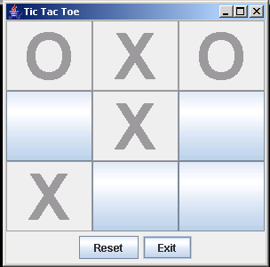
Tic-Tac-Toe
Problem Statement:
Design an interactive Tic-Tac-Toe board. The board should initially show nine empty squares.
Two players, X and O, alternately click on empty squares. Each time a player clicks a square, the appropriate symbol (X or O) appears in the square and that square (button) is disabled.
A Reset button clears the board.
An Exit button terminates the application.
X always makes the first move
Tic-Tac-Toe board after five moves

Slide 36
Tic-Tac-Toe
The application extends JFrame.
The constructor
instantiates two JButton objects: resetButton and exitButton,
registers a listener (ButtonListener) with each button,
places the buttons in a panel,
creates an array of nine JButton objects, one for each square of the Tic-Tac-Toe board,
registers a listener (ButtonListener) with each of the nine array buttons,
places the nine buttons in a panel using the GridLayout layout manager, and
places the two panels of buttons in the frame.

Slide 37
Tic-Tac-Toe
The inner class, ButtonListener, responds to button events.
This inner class implements the ActionListener interface and consequently actionPerformed(ActionEvent e)
If the source is the Reset button, all buttons are cleared of text and enabled.
If the source is the Exit button the application terminates.
If the source is one of the 9 board buttons, that button’s text is set ‘X’ or ‘O’, and the button is disabled.

Slide 38
The application
import java.awt.*;
import javax.swing.*;
import java.awt.event.*;
public class TicTacToeBoard extends JFrame
{
private JButton resetButton; // clear board
private JButton exitButton ; // ends game
private JButton[] board; // as a 3 by 3 grid of buttons
private int turn; // 1 for "X" and 0 for "O“
//The constructor
public TicTacToeBoard() // constructor builds the GUI
{
turn = 1; // for "'X"'
setTitle("Tic Tac Toe");
setBounds(0,0,300,300);
resetButton = new JButton("Reset");
exitButton = new JButton("Exit");
// register listener with buttons
resetButton.addActionListener(new ButtonListener());
exitButton.addActionListener(new ButtonListener());

Slide 39
Tic-Tac-Toe
// add buttons to a panel and
// add the panel to the bottom of the frame
JPanel bottomPanel = new JPanel();
bottomPanel.add(resetButton);
bottomPanel.add(exitButton);
// instantiate a Panel for the board
// use the GridLayout layout manager (3 by 3) for the board
JPanel boardPanel = new JPanel();
boardPanel.setLayout(new GridLayout(3,3));
board = new JButton[9];
for(int i = 0; i <9; i++)
{
board[i] = new JButton();
board[i].setFont(new Font("Arial", Font.BOLD, 72));
// register the listener for each button
board[i].addActionListener(new ButtonListener());
boardPanel.add(board[i]);
}
// add both panels to the frame
add(bottomPanel,BorderLayout.SOUTH);
add(boardPanel,BorderLayout.CENTER);
setVisible(true);
setDefaultCloseOperation(JFrame.EXIT_ON_CLOSE);
}

Slide 40
An inner class
private class ButtonListener implements ActionListener // responds to button event
{
public void actionPerformed(ActionEvent e) // ActionListener Interface method
{
if (e.getSource()== resetButton) // Reset button?
for(int i = 0; i <9; i++)
{
// remove X's and O's
board[i].setText("");
// enable all board buttons
board[i].setEnabled(true); turn = 1;
}
else if (e.getSource() == exitButton)
System.exit(0);

Slide 41
An Inner Class
else
for (int i = 0; i <9; i++) // for each board square
if (e.getSource() == board[i])
{
if (turn == 1) // X's turn
board[i].setText("X"); //put an "X" on the board
else // O's turn
board[i].setText("O"); //put an "O" on the board
board[i].setEnabled(false); // disable the button
turn = (turn+1)%2; // change turn designator, toggles 0 and 1
return; // source determined; return
}
}
}
// the main method
public static void main(String [] args)
{
TicTacToeBoard frame = new TicTacToeBoard();
}
}

Slide 42
Labels
A label is an area that can be used to display text or images. A label is not a source of events.
Class: JLabel
Constructors:
JLabel() instantiates a JLabel object that displays neither text nor an image.
JLabel (String text) instantiates a JLabel object with text, text.
JLabel(Icon icon) // e.g., JLabel label = new JLabel( new ImageIcon("pic.jpg")) instantiates a JLabel object that displays icon.

Slide 43
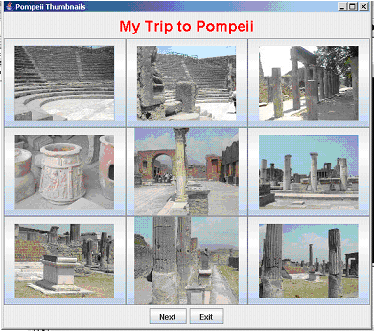
A Photo Album
Problem Statement:
Devise an application that displays nine thumbnail pictures in a single frame so that when a user clicks on any thumbnail, a full size version shows in another frame.
The lower panel of the thumbnail frame contains two buttons, a Next button and an Exit button.
When the Next button is clicked, the next batch of nine thumbnail pictures comes into view.
After the last thumbnail is shown, the display cycles around and the first thumbnail is once again displayed.
The Exit button terminates the application.

Slide 44
The Application
The application consists of three interacting classes:
PhotoAlbum
PhotoAlbum maintains two ArrayList<ImageIcon> objects: one list holds full size photos, the other thumbnails.
PhotoAlbum provides methods that return the number of photos, the ith photo, or the ith thumbnail.
This class is not part of the GUI. The class strictly maintains the data of the application.

Slide 45
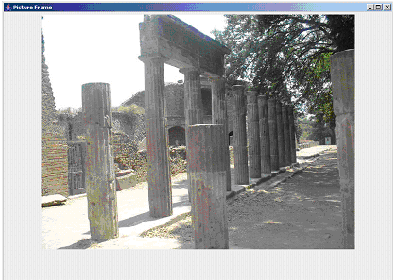
PictureFrame
PictureFrame
PictureFrame extends JFrame, displays a single picture on a label, and places the label in the center of a frame.
PictureFrame also provides a method that changes the picture.

Slide 46
ManagePhotos
ManagePhotos
ManagePhotos extends JFrame and contains three panels in the NORTH, CENTER, and SOUTH sections of the frame.
The NORTH panel holds a label that displays a title string. The title string of is “My Trip to Pompeii”.
The CENTER panel is a grid of nine buttons. Each button displays one thumbnail. Clicking a button displays the corresponding full size photo in a PictureFrame object.
The SOUTH panel contains two buttons, nextButton and exitButton. Clicking nextButton changes the nine pictures in the center grid. The nextButton is disabled if there are fewer than ten pictures.
ManagePhotos includes a call to validate(), which is defined in Container. Sun’s documentation states:
AWT uses validate() to cause a container to lay out its subcomponents again after the components it contains have been added to or modified.

Slide 47
The PhotoAlbum class
import java.awt.*;
import javax.swing.*;
import java.util.*; // for ArrayList
import java.io.*;
public class PhotoAlbum
{
ArrayList<ImageIcon> thumbnails; // holds thumbnail pics
ArrayList<ImageIcon> photos; // holds full size pics
public PhotoAlbum() // constructor, adds thephotos and thumbnails to the ArrayLists
{
thumbnails = new ArrayList<ImageIcon> (); // set initial capacity
photos = new ArrayList<ImageIcon>();
int picNum = 0;

Slide 48
Constructor
while((new File("Pompeii/thumbnail"+picNum+".jpg").exists())) // for each photo
{
ImageIcon thumb = new ImageIcon ("Pompeii/thumbnail"+picNum+".jpg"); //thumbnail0.jpg, etc.
ImageIcon full = new ImageIcon("Pompeii/photo"+picNum+".jpg"); //phote0.jpg,
thumbnails.add(thumb); // adds to the end of the ArrayList
photos.add(full);
picNum++;
}
}
public ImageIcon getPhoto(int i) // returns the ith photo
{
return photos.get(i);
}
public ImageIcon getThumbnail(int i) // returns the ith thumbnail
{
return thumbnails.get(i);
}
public int numPhotos() // number of photos in the album
{
return photos.size();
}
}

Slide 49
PictureFrame Class
import java.awt.*;
import javax.swing.*;
public class PictureFrame extends JFrame
{
private JLabel pictureLabel;
private JPanel picturePanel;
public PictureFrame() // default constructor
{
super("Picture Frame"); // invoke parent constructor
JFrame PictureFrame = new JFrame();
// Make the frame fill the entire screen
Toolkit tk = Toolkit.getDefaultToolkit();
Dimension dim = tk.getScreenSize(); // returns screen width, height
setBounds(0,0, dim.width, dim.height);
// place a label in a panel; place the panel the frame
pictureLabel = new JLabel();
picturePanel = new JPanel();
picturePanel.add(pictureLabel);
add(picturePanel, BorderLayout.CENTER);
}
public void changePhoto(Icon icon)
//change the picture displayed in the frame by changing
// the picture displayed in the label
{
pictureLabel.setIcon(icon);
}
}

Slide 50
ManagePhotos class
import java.awt.*;
import javax.swing.*;
import java.awt.event.*;
public class ManagePhotos extends JFrame
{
private JButton nextButton; // to show the next 9 thumbnails
private JButton exitButton; // exit application
private JPanel buttonPanel; // for the next and Exit buttons
private PhotoAlbum album; // holds photos and thumbnails
private JButton[] display; // one button for each thumbnail
private JPanel displayPanel; // holds 9 thumbnail buttons
private JLabel titleLabel; // Displays title of the display
private JPanel titlePanel; // Holds the title label
private PictureFrame pictureFrame; // displays one large photo
int nextPicture; //number of next thumbnail placed in the display

Slide 51
The default constructor
public ManagePhotos() // default constructor
{
setTitle("Pompeii Thumbnails");
setBounds(0,0,600,500);
album = new PhotoAlbum();
// create the title label and place it in a panel
titleLabel = new JLabel();
titleLabel.setFont(new Font("Comic Sans Serif", Font.BOLD,24));
titleLabel.setForeground(Color.RED);
titleLabel.setText("My Trip to Pompeii");
titlePanel = new JPanel();
titlePanel.add(titleLabel);
// create the buttons and place them in a panel
nextButton = new JButton("Next");
if (album.numPhotos() <=9)
nextButton.setEnabled(false);
exitButton = new JButton("Exit");
buttonPanel = new JPanel();
buttonPanel.add(nextButton);// add the two buttons to the panel
buttonPanel.add(exitButton);
// register the listener for the buttons
nextButton.addActionListener(new ButtonListener());
exitButton.addActionListener(new ButtonListener());

Slide 52
The Constructor
// create a button for each thumbnail and register a listener with each button
display = new JButton[album.numPhotos()];
for (int i = 0; i < album.numPhotos(); i++)
{
display[i] = new JButton(album.getThumbnail(i)); // populate the array
display[i].addActionListener(new ButtonListener()); // register a listener thumbnails
}
displayPanel = new JPanel(); // panel holds 9 buttons that display thumbnails
displayPanel.setLayout(new GridLayout(3,3));
for (int i = 0; i < 9; i++) // place the thumbnails in a panel for the first nine thumbnails
if (i < album.numPhotos())
displayPanel.add(display[i]);
// place the three panels in the frame
add(titlePanel, BorderLayout.NORTH);
add(buttonPanel,BorderLayout.SOUTH);
add(displayPanel,BorderLayout.CENTER);
if (album.numPhotos() <9) // reset nextPicture
nextPicture = 0;
else
nextPicture = 9;
setVisible(true);
// create an empty PictureFrame object that displays a photo
pictureFrame = new PictureFrame();
}

Slide 53
Listener
// responds to button events
private class ButtonListener implements ActionListener
{
// method in the ActionListener interface
public void actionPerformed(ActionEvent e)
{
if (e.getSource()== nextButton)
{
remove(displayPanel); // the current display of thumbnails
displayPanel = new JPanel();
displayPanel.setLayout(new GridLayout(3,3));
for(int i = 1; i <=9; i++) // display next 9 thumbnails
{
displayPanel.add(display[nextPicture]);
// increment nextPicture and wrap around to 0
nextPicture = (nextPicture+1) % album.numPhotos();
}
add(displayPanel, BorderLayout.CENTER);
validate(); // layout the components of the frame again
}

Slide 54
Listener
else if (e.getSource() == exitButton)
{
System.exit(0);
}
else // determine which thumbnail button was clicked
for(int i = 0; i < (album.numPhotos()); i++)
{
if (e.getSource() == display[i]) // clicked on a thumbnail
{
pictureFrame.changePhoto(album.getPhoto(i)); // change the large photo
pictureFrame.setVisible(true);
return;
}
}
}
}
public static void main(String[] args)
{
ManagePhotos frame = new ManagePhotos();
}
}

